Slide 1
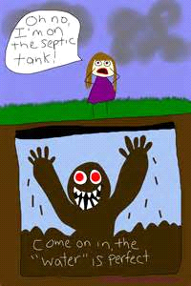
The Septic
To the words of
The River
by Garth Brooks

Slide 2
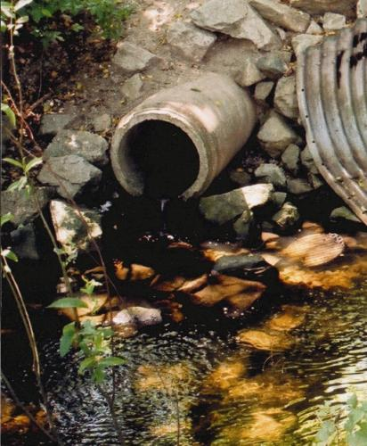
You know your pipes are like a river
Every drain creates more flow

Slide 3
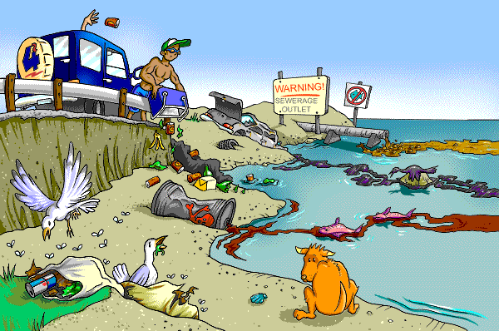
And the waste is just more water
That must follow where it goes

Slide 4
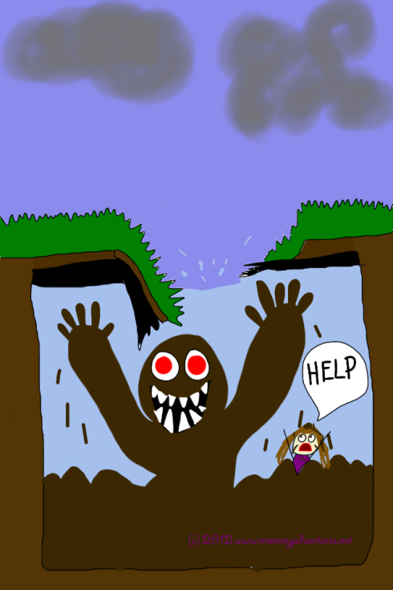
Pushing the waste that came before it
And praying it won’t overflow

Slide 5
Makes each day a constant battle
Just to flush the commode

Slide 6
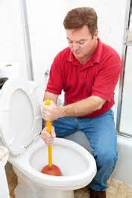
And I will load my septic
‘Til the toilet overflows

Slide 7
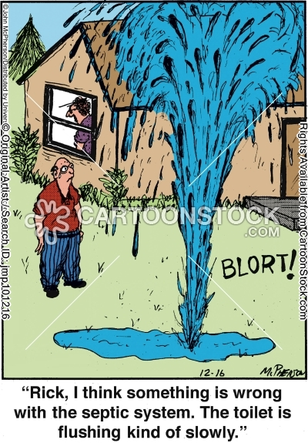
Like a stick of dynamite
These pipes are gonna blow

Slide 8
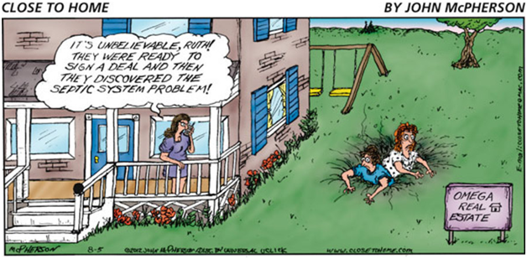
You’ll never know there is a problem
If it never shows

Slide 9
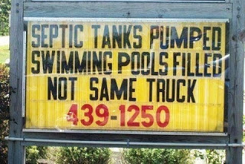
So I will load my septic
‘Til the toilet overflows

Slide 10
Create Your Own Water Pollution Karaoke Lyrics
Take me to the River (Talking Heads): https://www.youtube.com/watch?v=6ar2VHW1i2w
Bridge over Troubled Water (Simon and Garfunkel): https://www.youtube.com/watch?v=H_a46WJ1viA
Rain King (Counting Crows): https://www.youtube.com/watch?v=izeDRfkyMAQ
Don’t Drink the Water (Brad Paisley): https://www.youtube.com/watch?v=76YU14Jox_8
Ripple (Grateful Dead): https://www.youtube.com/watch?v=671AgW9xSiA

